Slide 1
Iteration 3 Status
1
GUI Automation using OpenCV
https://github.com/utastudents/ShapeRecipe.git
CSE-6324-001 TEAM 1
Harsh Chaludia
Deep Patel

Slide 2
STATUS SUMMARY
How can we improve the CURRENT DESIGN ?
How do we move forward with ALPHABETS ?
How we are going with REACT NATIVE ?
Download the EXPO Code
Provide Instructions for Android / IOS
Zip the code to the USER

Slide 3


PROGRESS
From last Iteration, we had the following observations.
IMPLICATIONS
MODIFICATIONS
Last time we discussed about incorporating NUMBERS with SHAPES. And, while testing with both the entities, we faced design issues.
To visualize the responsive code on React Native, we were not sure about how to visualize the code before the user downloads the code.
We didn’t have any strategy for alphabets to be incorporated.
Before, we were not having, something for the user to download code for website, or react native.
To overcome the complex design, we took feedback from two users, and we decided to keep shapes, and numbers in a separate filter.
We will provide instructions, for the code to be rendered on USERs device. Like will provide commands, and will tell them what apps to download to test the DESIGNED APP.
Now, just as we did for numbers using MNIST dataset, and we are going to use the EMNIST Dataset for using alphabets (a-z).
Now, we have decided to show buttons, which will help the user to download the design into website or mobile, as per their selection

Slide 4
DIGIT RECOGNITION
4
What do we have in DIGIT Recognition Feature ?
We can now have 0-9 digits being used in our design.
Each of these digits can now be matched to a particular element of an HTML.
Currently, we just have mapped 0-6 digit, same like shapes, because as said before, we will use digits feature as a separate design to be integrated.
After Shapes, and Numbers, this is going to be our third feature.
We will see how things are working in the next slide……

Slide 5
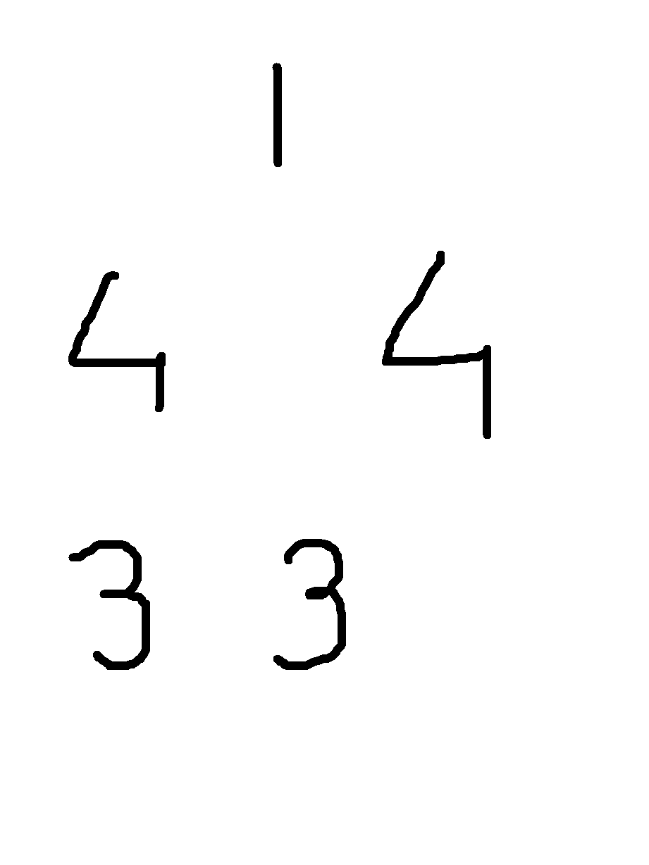
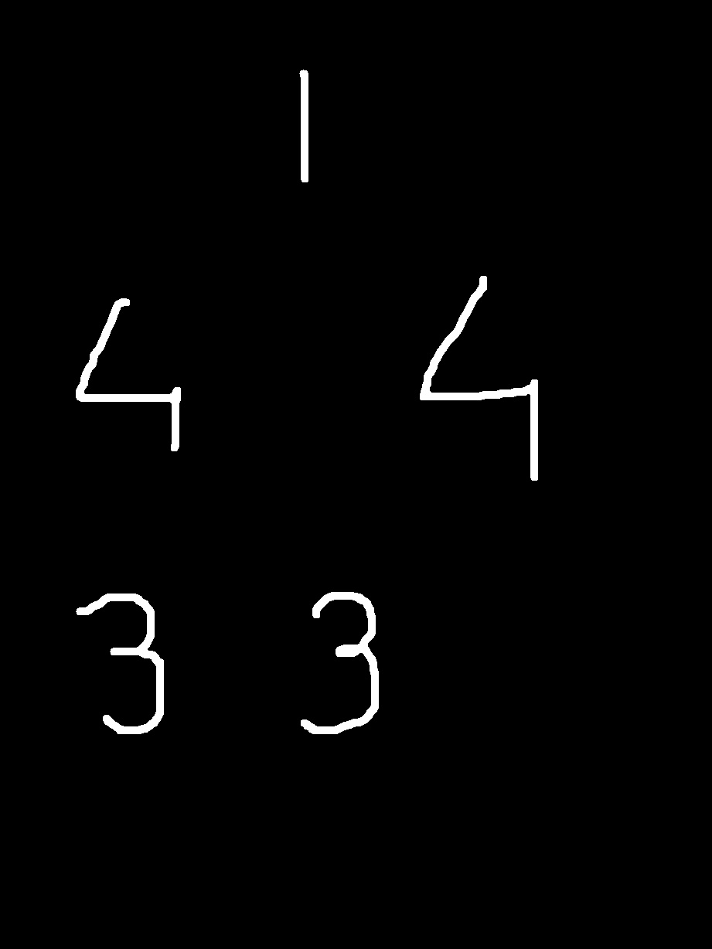
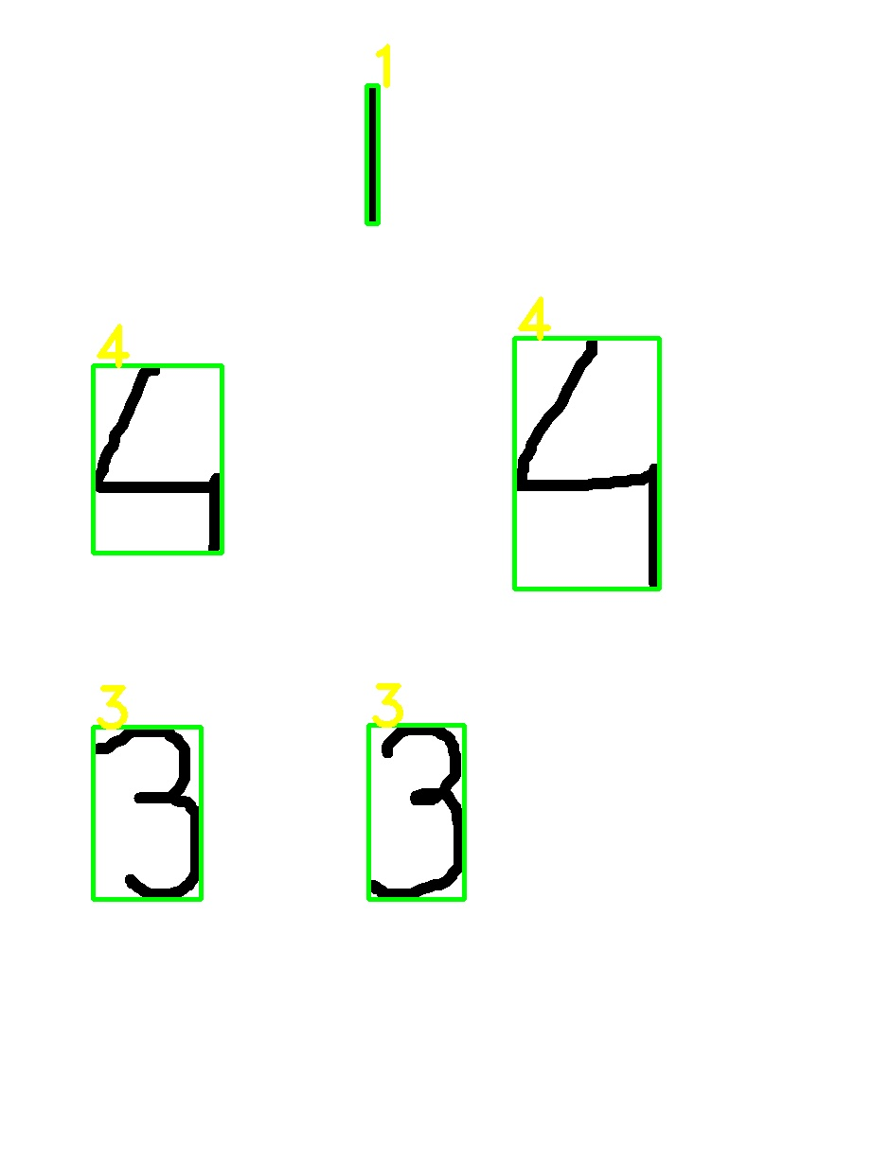
5
DIGIT RECOGNITION
Labeled Image
Original Image
Dilated Image

Slide 6
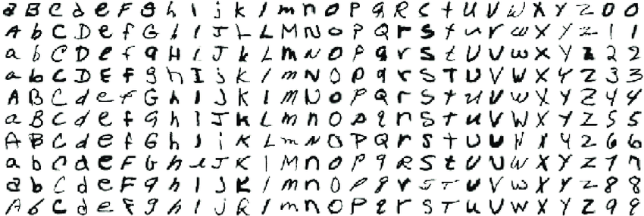
ALGORITHM
For Letters (a-z) Detection,
We are using EMNIST letter dataset sample. It was made with the same idea of MNIST, but with alphabets.
First, we will go pre-processing(Deskewing), next we calculate HOG (Histogram of Oriented Gradients) descriptor, and finally we train the model, followed by testing some letters to get accuracies.
Letter Dataset from EMNIST

Slide 7
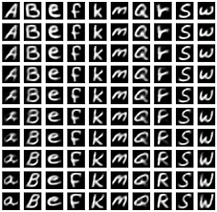
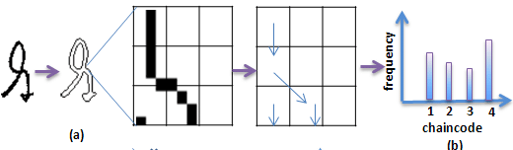
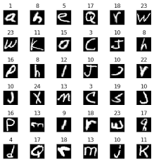
ALGORITHM
2. Histogram of Oriented Gradients descriptor [2]
1. Deskewing [1]
3. Training and testing model. [3]

Slide 8
MOBILE DESIGN
8
What do we have in here?
We found a way to map the website code onto react native environment. And, the website code already being responsive, made it easy for us to integrate.
What more can we include ?
We can actually create some download functionality where the user gets the zipped expo code (i.e React Native). This code when converted into respective binaries, can be deployed on android/ ios.

Slide 9
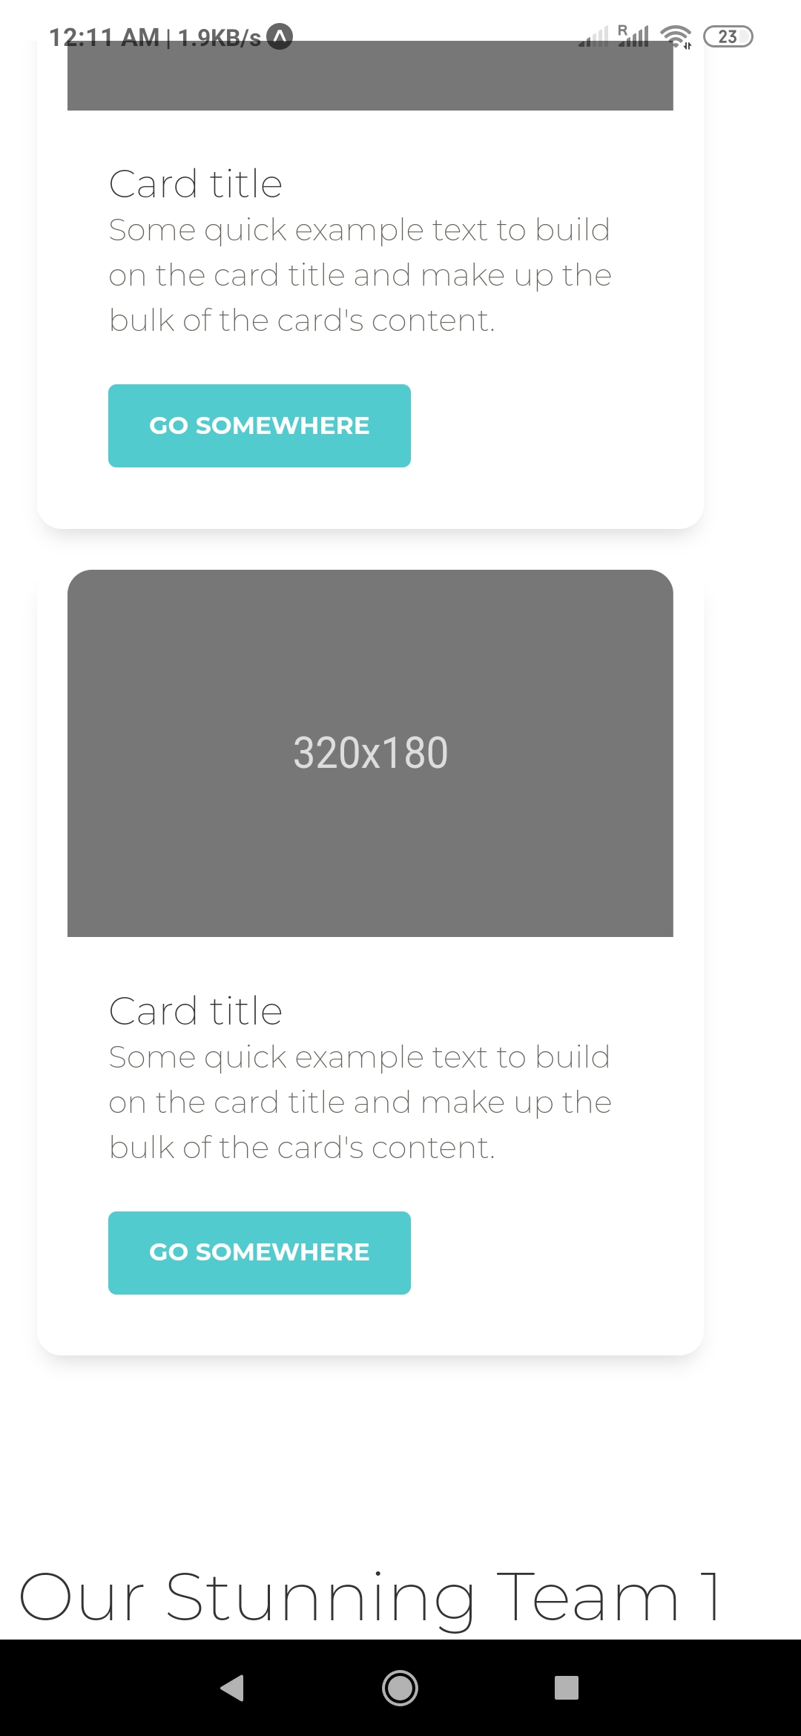
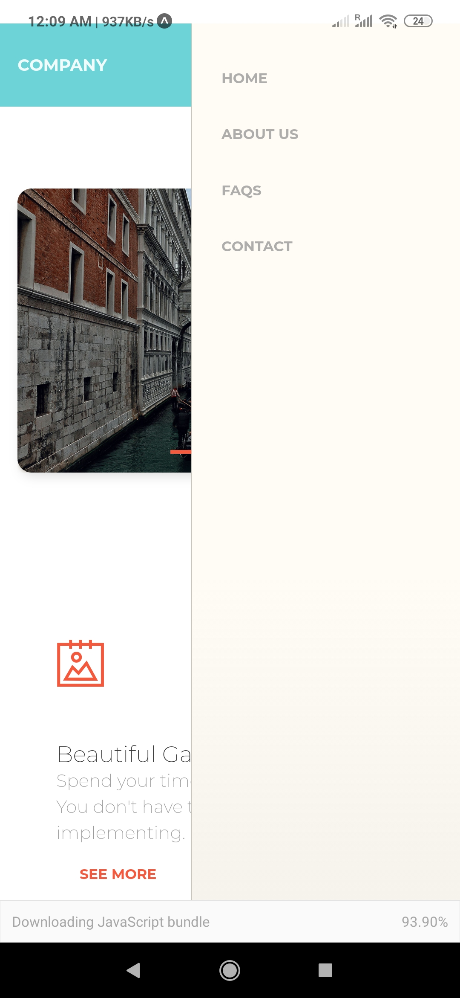
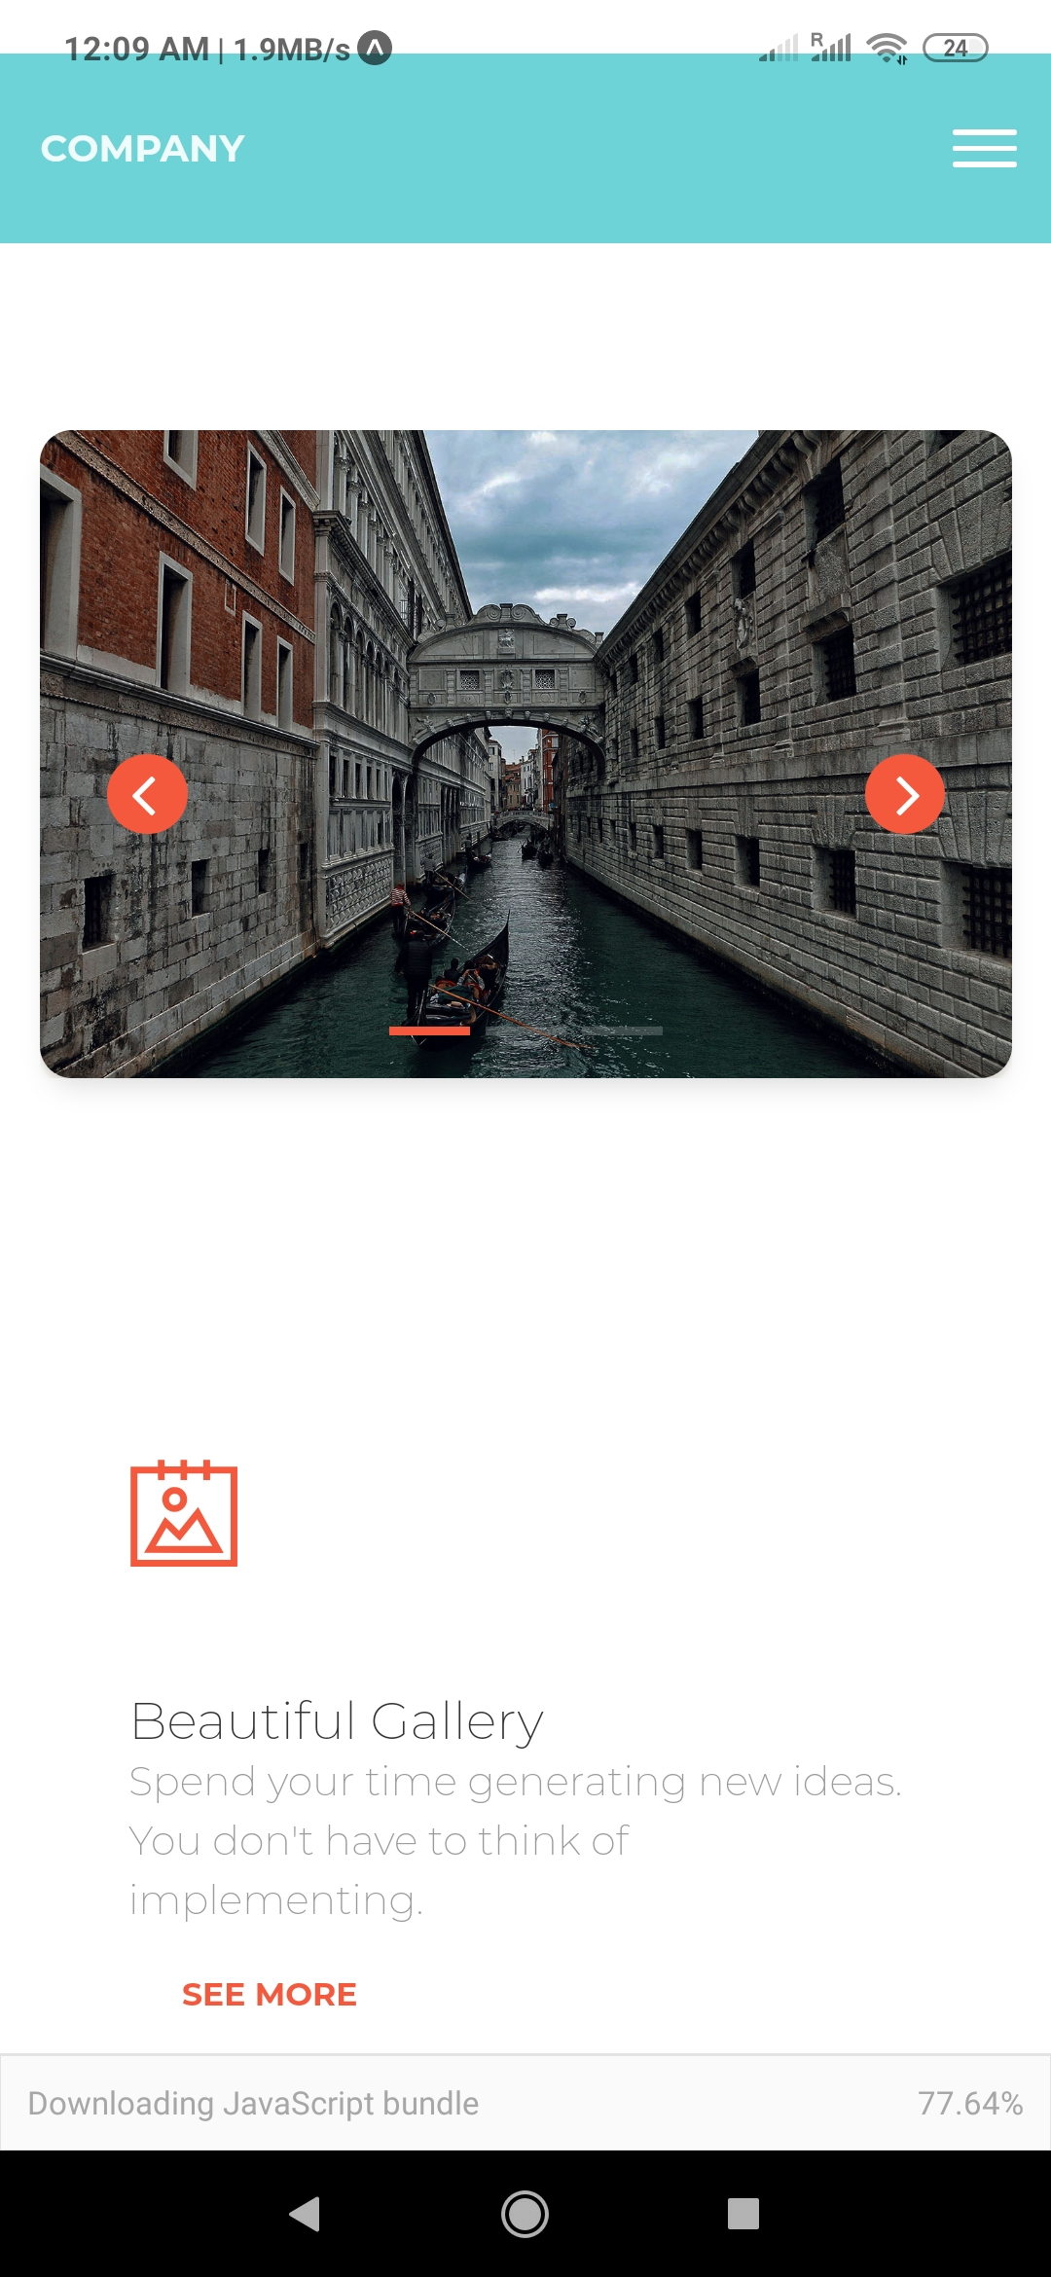
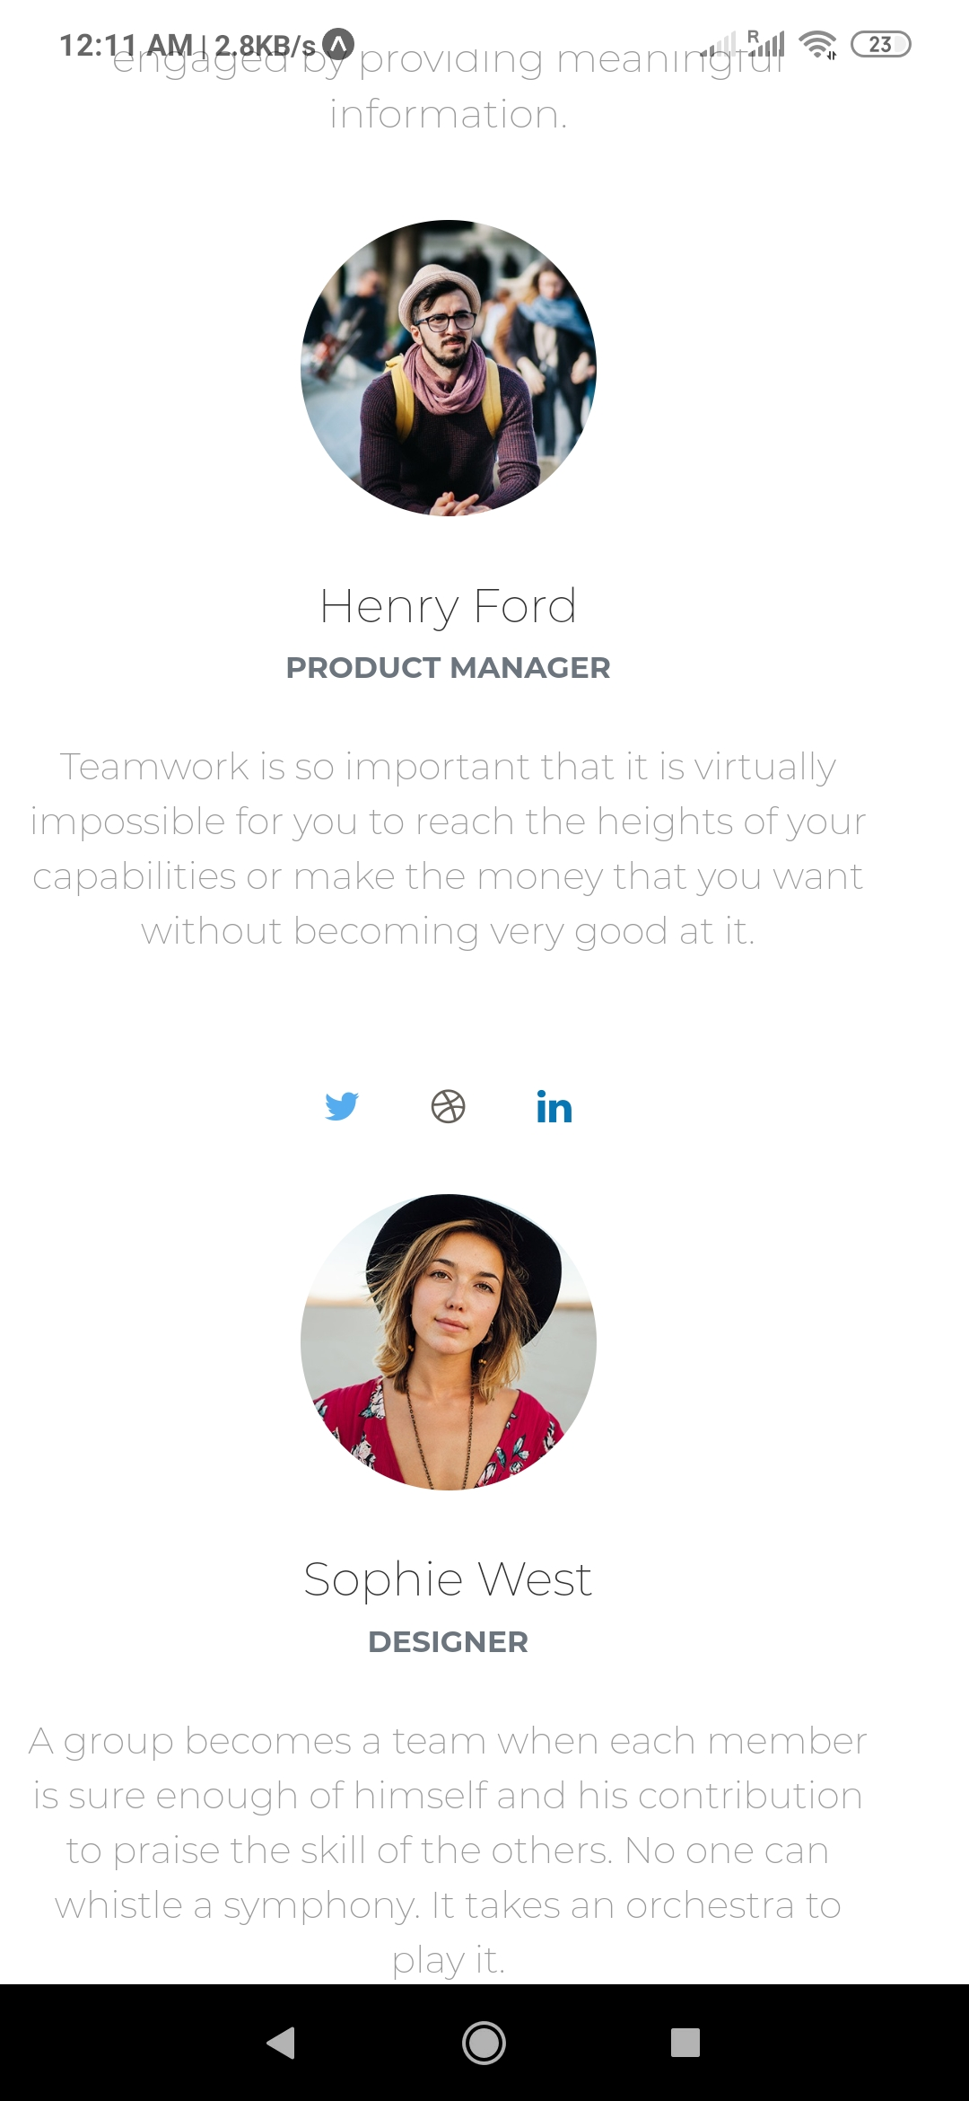
MOBILE DESIGN
9

Slide 10
DELIVERIES
CRITICAL DELIVERABLES
The Number recognition module is complete.
The React Native Mobile View, is now available.
More..
To decide a one page strategy for users, to know before they sketch the design.
Now, we have a filter for numbers, for users to design with digits.
We tested the mobile view, and pretty much the code works all good.
Pass all the tests for digit recognition.

Slide 11
GOALS FOR NEXT ITERATION
DATE OF NEXT STATUS UPDATE
LIST GOALS FOR NEXT ITERATION
Complete the MOBILE tests.
Go for the alphabets recognition module.
Introduce a feature to download the design as well.
ACTION PLAN REVIEW
The user can have a way to save the design onto the UTA cloud. If she/he doesn’t want to download the code.
December 1, 2020

Slide 12
REFERENCES
ONLINE RESOURCES
https://www.researchgate.net/figure/Samples-of-all-letters-and-digits-in-the-EMNIST-dataset_fig2_334957576 [1]
https://arxiv.org/pdf/1803.01900.pdf [2]
https://www.simonwenkel.com/2019/07/16/exploring-EMNIST.html. [3]

Slide 13
THANK YOU
TIME FOR A DEMO

